Slide 1
Coastal erosion and vulnerability in the Bay of Lalzit (AL)
Summary of the research
12/10/2022
Francesco De Leo
Giovanni Besio
Guido Zolezzi

Slide 2
UNESCO Chair
Engineering for Human and Sustainable Development
2013: Vermosh, Albany (hydrogeolocal risk protection)
partners: VIS Albany, Tirana Polytechnic, Kelmend Municipality
2014: Mkuru, Tanzania (water resources management)
partners: OIKOS institute, Uwiro Municipality
2015: Lalzit bay, Albany (coastal erosion)
partners: VIS Albany, Tirana Polytechnic, Environment albanian ministery

Slide 3
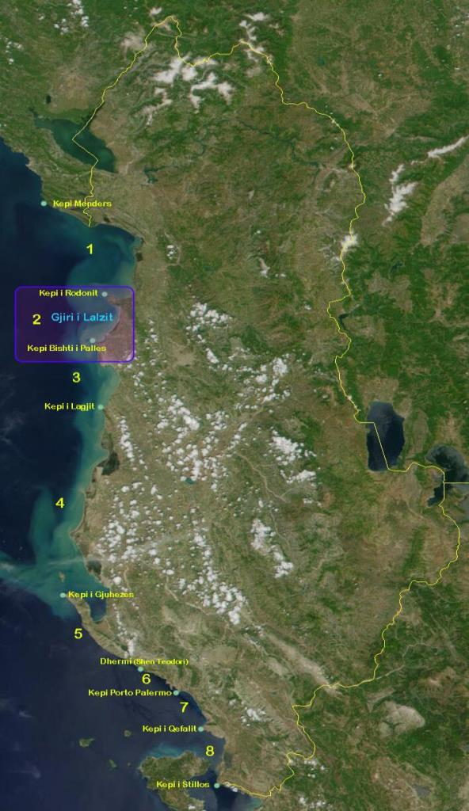
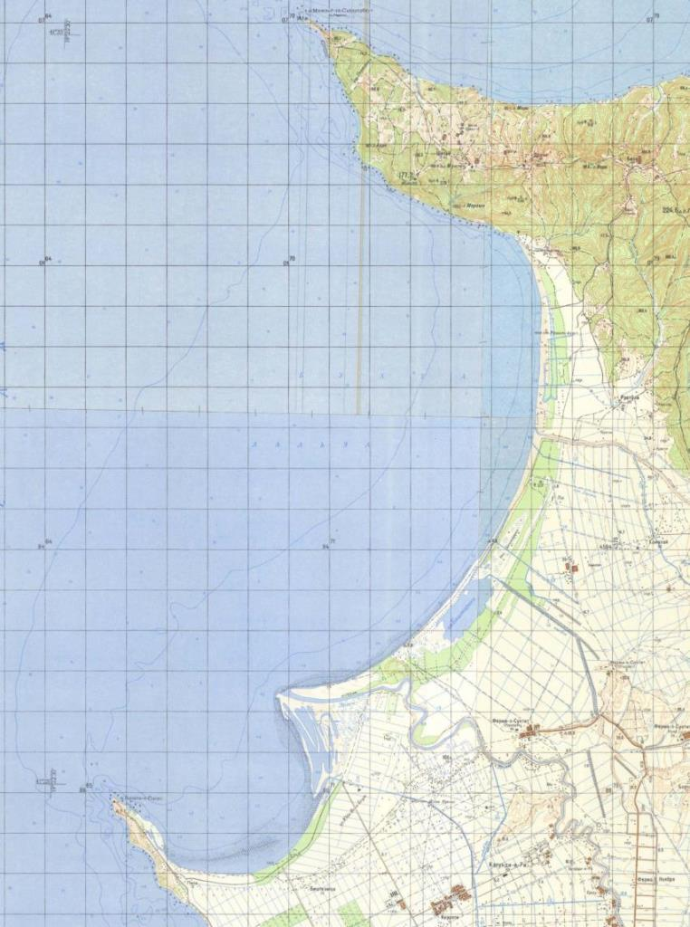
$≈$700 m retreat

Slide 4
GOALS
Understanding the possible causes of the coastal erosion in the Lalzit Bay
Identifying the territory management policies to address the challenges
The working team
5 Professors (Guido Zolezzi, Marco Bezzi, Giovanni Besio, Tania Floqi, Idlir Lami)
26 students
Period: 21/07/2015 - 31/07/2015

Slide 5
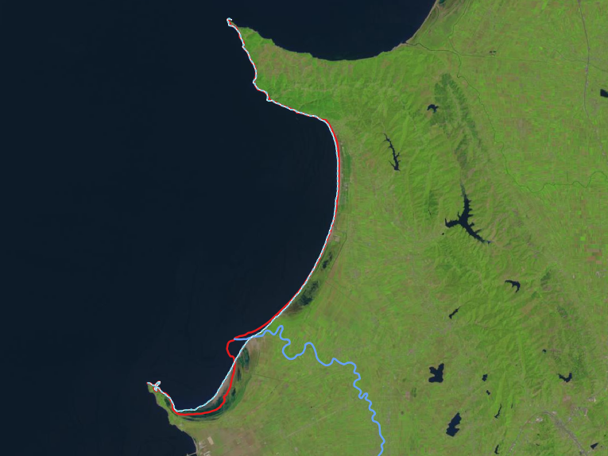
General view
1984
2014
3.Human activities
1.Sea waves
2.Erzeni River morphodynamics

Slide 6
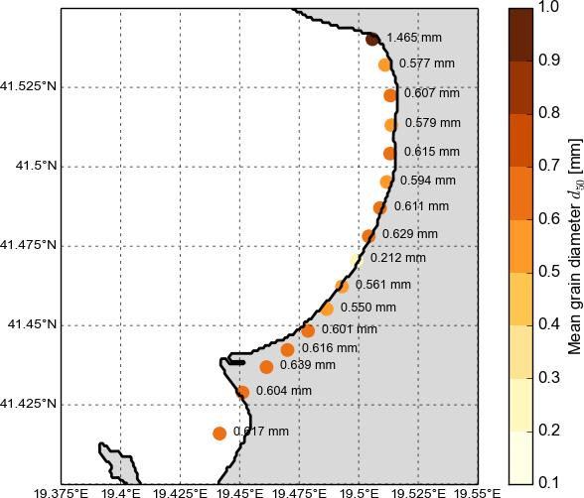
1. WAVE CLIMATE INDUCE MORPHODYNAMIC
Local grain size distribution

Slide 7
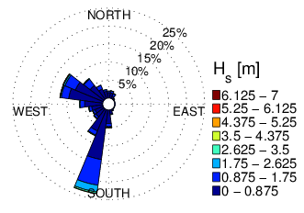
1. WAVE CLIMATE INDUCE MORPHODYNAMIC
Local wave climate
1979 - 2020
H_{s}, T_{m}, θ_{m}
hourly resolution

Slide 8
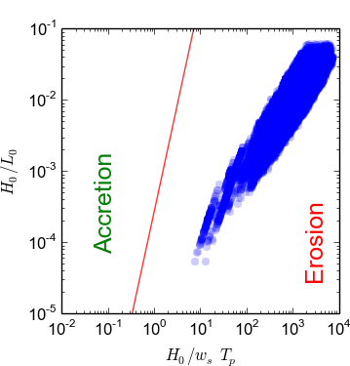
1. WAVE CLIMATE INDUCE MORPHODYNAMIC

Slide 9
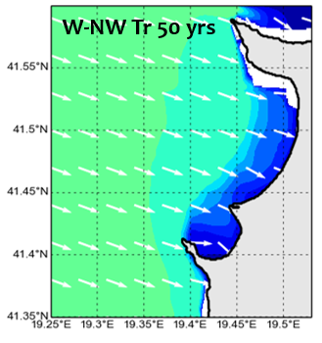
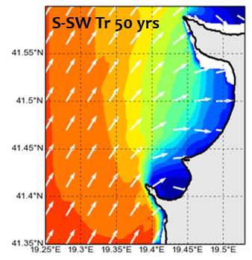
1. WAVE CLIMATE INDUCE MORPHODYNAMIC

Slide 10
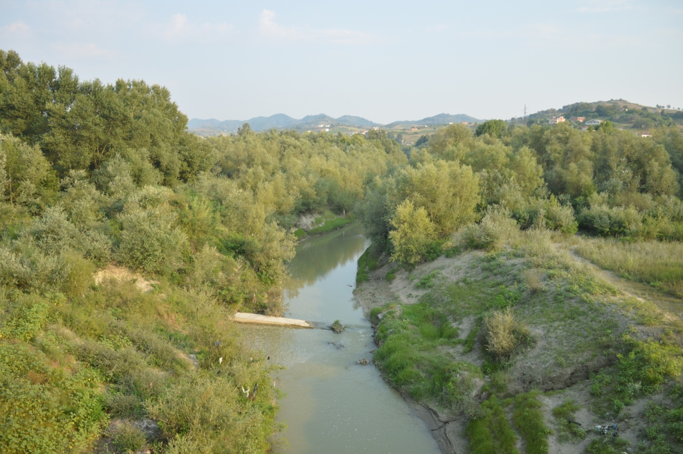
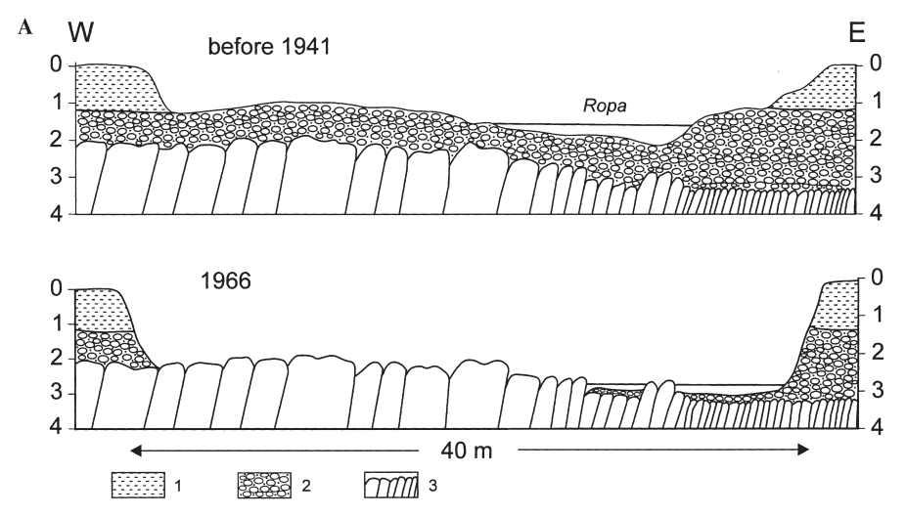
2. ERZENI RIVER CONTRIBUTION
> 57 years old
River bed is 2 m shallower than it was before the 90's
Banks are no longer flooded
10 – 15 years old
Ropa River
(Rinaldi 2005)

Slide 11
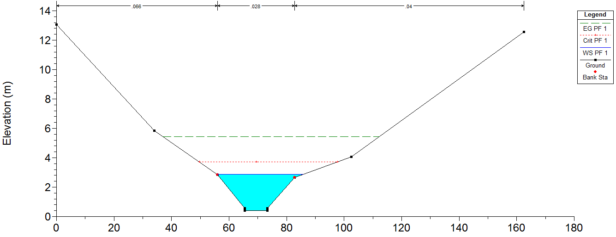
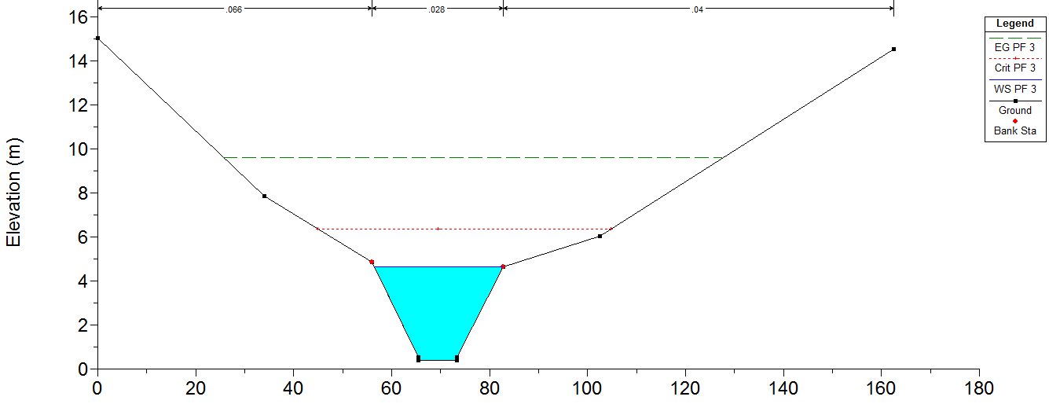
2. ERZENI RIVER CONTRIBUTION
Q_{b} = 180 m³/s
Q_{b} = 350 m³/s

Slide 12
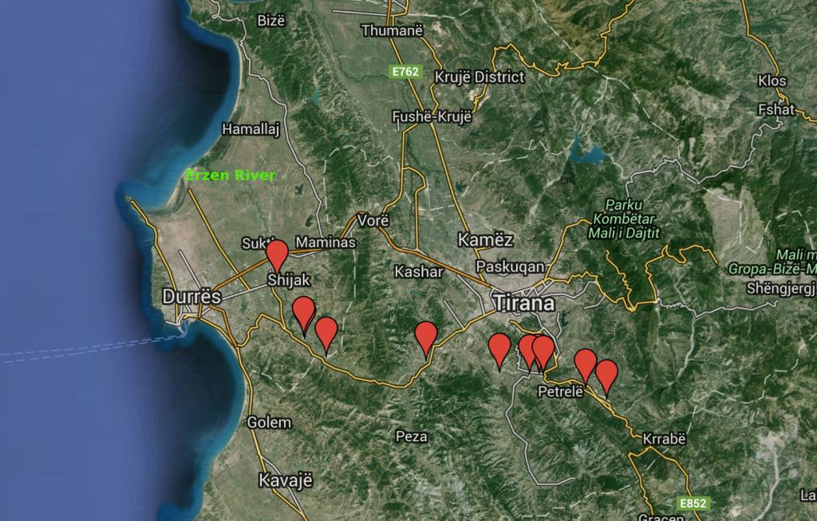
3. HUMAN ACTIVITIES
The quarries

Slide 13
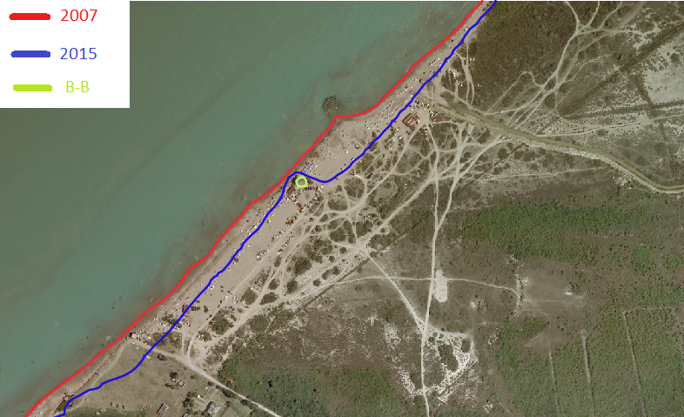
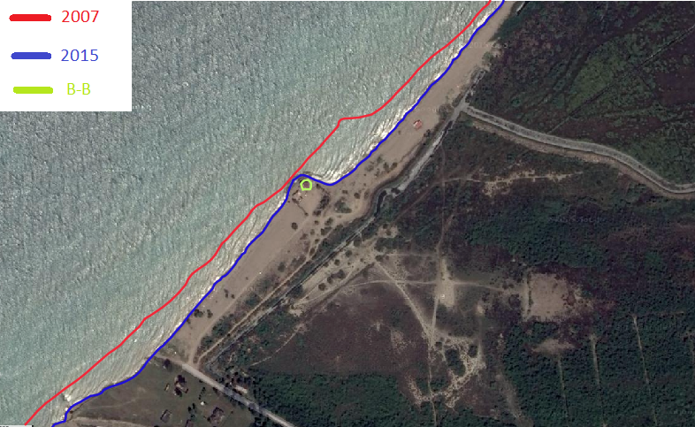
RESULTS
Local beaches naturally tend to erode due to their morphology and local wave climate
Sediment supply from the river has dramatically decreased due to quarries activities and bed incision
The Bay of Lalzit is facing a massive erosion in the area of the Erzeni River outflow

Slide 14
WHAT CAN BE DONE?
Nourishments and coastal defense structures to slowdown coastal erosion
Restore Erzeni River sediment supply
REFERENCES
De Leo, F., Besio, G., Zolezzi, G., & Bezzi, M. (2019). Coastal vulnerability assessment: through regional to local downscaling of wave characteristics along the Bay of Lalzit (Albania). Natural Hazards and Earth System Sciences, 19(1), 287-298.
De Leo, F., Besio, G., Zolezzi, G., Bezzi, M., Floqi, T., & Lami, I. (2017). Coastal erosion triggered by political and socio-economical abrupt changes: The case of Lalzit Bay, Albania. Coastal Engineering Proceedings, (35), 13-13.

